Slide 1
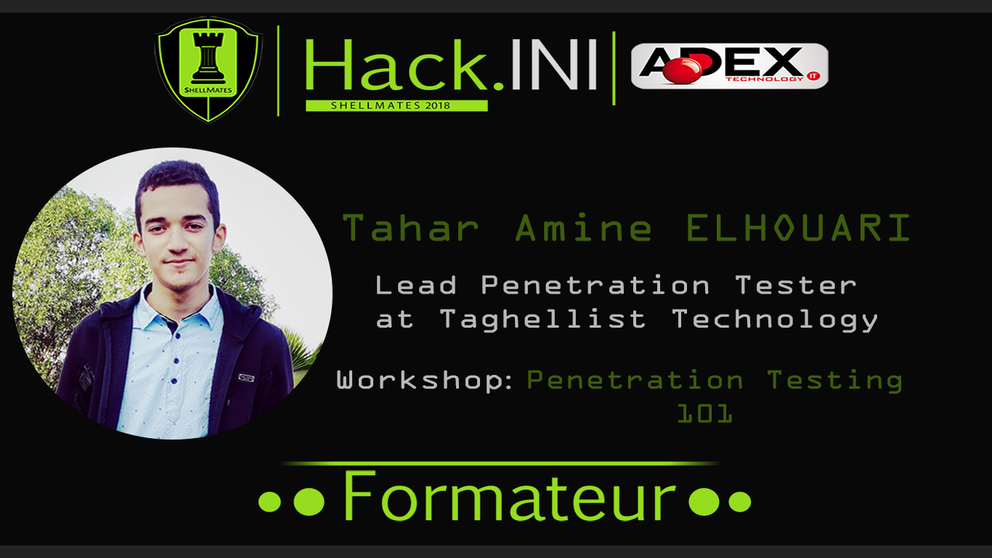

Slide 2
ssh root@taharamine.shellmates.org
The authenticity of host ‘taharamine.shellmates.org’ can't be established.
RSA key fingerprint is da:e5:96:49:99:75:d7:79:45:75:7d:62:0c:5a:1f:0d.
Are you sure you want to continue connecting (yes/no)?
yes,
_
_
Welcome root!
root@shellmates~#
startx,
_
_
Initialising Xorg server... [ok]
Running Desktop ... [ok]
[06:31:09] Loading user config ...
[06:31:09] Loading user preferences ...
Last login on 13/02/2018 @ 06:31:09 from : taharamine.me
Notes:
(Présentation du speaker)

Slide 3
Overview:
Terms.
What is Penetration Testing?
Benefits of doing a Pen-Test!
Pen-Testing Teams/Models/Types.
Pen-Testing Methodologies/Tools/Skills.
Pen-Testing Certifications/Platforms.
Questions!
Hands-On Penetration Testing.
Contact Me!

Slide 4

Terms:
Penetration Tester
Penetration Testing

Slide 5
Penetration Testing
Penetration Test, known as a Pen-Test, is an authorized simulated attack on a computer system, performed to evaluate the security of the system.

Slide 6
Benefits of doing a Pen-Test:
Protect Clients, Partners and Third Parties.
Show real risk and reveal vulnerabilities.
Avoid the cost of network downtime.
Preserve corporate image and customer loyalty and protect the public relationships.
Evaluate Security Investment.
Testing the ability of network defenders to successfully detect and respond to the attacks.

Slide 7
Penetration Testing Teams:
Red Team: Offensive Guys, their main objective is to attack and exploit.
Blue Team: Defensive Guys. Known as IT Security Team, their main goal is to achieve security and walls against the attackers.
Purple Team: The bridge between both of the Red Team and the Blue Team.

Slide 8
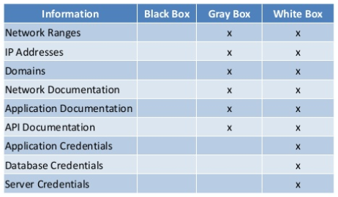
Penetration Testing Models:
Black Box Testing: Real world hacking without any given information.
White Box Testing: Known as Clear-Box Testing, the Pen-Tester has full knowledge on the infrastructure of the target.
Gray Box Testing: The name explains everything, Its like a part of black & white testing.

Slide 9
Penetration Testing Types:
Network Penetration Testing.
Web Application Penetration Testing.
Application Penetration Testing.
Wireless Penetration Testing.
Social Engineering Penetration Testing.
Hardware Penetration Testing.
Compliance Penetration Testing etc..

Slide 10
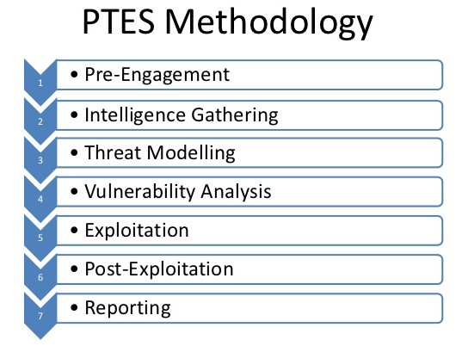
Penetration Testing Methodologies:
PTES Penetration Testing Execution Standards
Other Methodologies: OWASP/OSSTMM..
www.pentest-standard.org

Slide 11
My Pen-Testing Methodology:
Kick Start: Cost/Testing Scope/Timeline/Risks..
Information Gathering: Active & Passive Recon.
Vulnerability Analysis: Scanning & Enumeration.
Exploitation: Gaining Access to the System.
Post-Exploitation: Priv-Escal & Maintaining Access..
Cleaning Up & Clearing Things.
Reporting: Creating & Reviewing the Report..
Remediation: Recommendations & Best Practices.

Slide 12
Penetration Testing Tools:
Distributions: Kali Linux, Parrot Security OS, BlackArch, BackBox..
Toolkits & Frameworks: Nmap, Metasploit, Burp Suite, SEToolkit, Nessus, OpenVAS, NetCat, John The Ripper..

Slide 13
Penetration Testing Skills:
Computer Science
Systems Administration
Basics of Networking
Scripting & Programming
Basics of Security
Ability to Search
The Hacker Mindset.

Slide 14




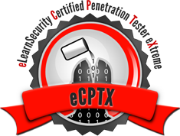

Penetration Testing Certifications:

Slide 15


Penetration Testing Platforms:
http://www.taharamine.me/2018/02/hacking-environments-and-platforms.html

Slide 16
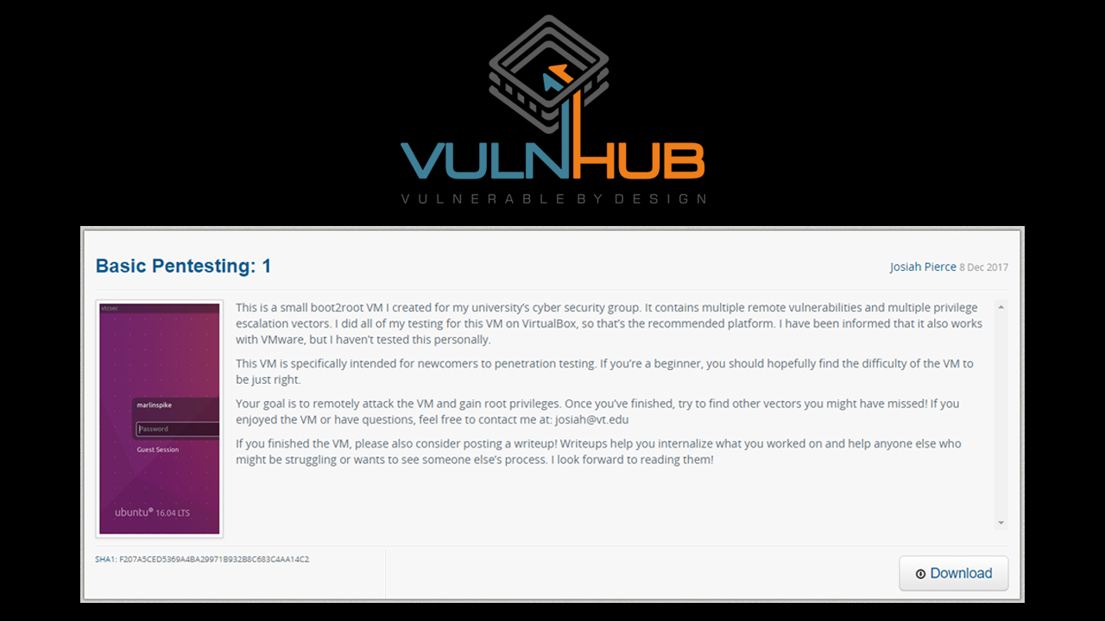

Slide 17
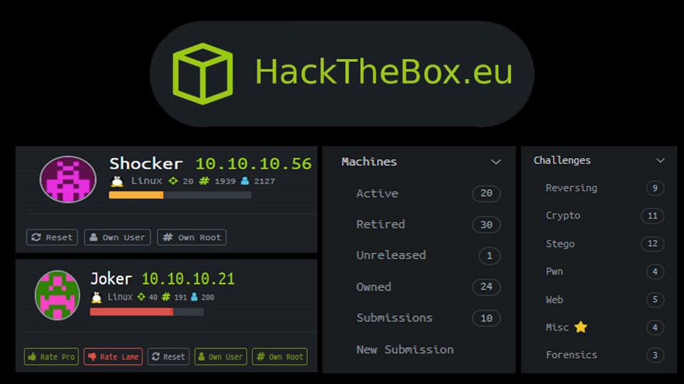
Notes:
Penetration Testing Platforms

Slide 18
#Questions!

Slide 19

Hands-On
We have a practical Virtual Machine to simulate a real life scenario Penetration Testing.

Slide 20



$_uname:
Username: @MrTaharAmine
Website: www.taharamine.me
E-mail: taharamine@tuta.io

